Slide 1
Load Testing
January 2018
René Ernst

Slide 2
Agenda
What is Load Testing?
Load Test Development Cycle
Discuss each step in Development Cycle
Questions?
Notes:
Implementation of a load test is often underestimated. This presentation explains that this involves more than just recording a script or performing many simultaneous transactions.
The steps that are required for succesful implementation are similar to those of any custom made application.
This presentation covers these steps: Requirements analysis, Design, Implementation, Quality Assurance and Execution.
load tests are often performed using an automated tool. The tool used with examples throughout this presentation is LoadRunner (from Mercury, nowadays HP). The design steps are independent from the tool being used, and are therefore also applicable to for instance Rational´s Performance Tester.

Slide 3

What is Load Testing?
Non-functional testing
  Demonstrate that the system functions to specification with acceptable response times while processing the required transaction volumes on production sized data using production sized test environment.

Slide 4
What is Load Testing?
Load Testing is more than determining response times
  Determine if response time requirements are met at different load levels
  Identify bottlenecks in architecture
  Detect obscure software bugs
  Tune the system to optimize performance
  Verify stability
  Observe behavior of system under test

Slide 5

What is Load Testing?
Scenario | Description | Purpose
Peak Load Test | Simulate production peak load during relatively short period (e.g., 2 hours) | Validate performance and resource usage requirements under production peak load.
Endurance Test | Simulate production load for a long period (several days to week) | Demonstrate that the system remains stable under load, for a long period. Typically test for: Memory leaks Full file systems (log files)
Stress test | Gradually increase load until system no longer meets performance requirements, then gradually decrease load. | Demonstrate: Spare capacity of the system Error handling in overload situation Recoverability
Notes:
First let´s start with explanation of some terms commonly used with load testing.
A load test is a test where focus is on the end-to-end response times of the application. This test can be executed manually, with a single user.
A peak load test is a test that simulates the production load during peak hour. The purpose of this test is to validate both performance requirements by measuring end-to-end and transaction (DB2/IMS) response times, as well as measuring resource usage (e.g. CPU and memory usage, average CPU usage per DB2/IMS transaction etc.). A peak load test lasts for a relatively short period (1-2 hours)
A volume or endurance test is a test during which a high load is sustained over a longer period of time (several days to a week). The purpose of this test is to verify that the system remains stable load over a long period. Attention points are: memory leaks, file system usage (log files and log file rotation).
A stress test is a short test (up to 4 hours) during which the load is increased above the expected production peak load. The load is brought to peak load, then increased to for instance twice the peak load, and then regularly decreased to peak load. This test verifies the spare capacity of the delivered system, as well as the recoverability of the system after the load his decreased. Also the weakest component (the component that is the first to fail) can be identified. The system or component is failing when it no longer meets the performance requirements.

Slide 6
What is Load Testing?
Test Script
  Set of actions to be executed by one or more simulated users
  One script per use case (focus on normal flow)
  Can be recorded, results in (C or Java) code
Virtual user (Vuser)
  One real user, simulated by computer program
  One Vuser executes one script
  Many Vusers can run the same script
  One Vuser can simulate multiple real users

Slide 7
What is Load Testing?
Scenario or Schedule:
  Combines scripts and Vusers
  Typical Scenarios for:
    Peak load test or Future peak load test
    Endurance test
    Stress test

Slide 8
Load Test Development Cycle
Execution &
Reporting
Requirements
Analysis
Quality
Assurance
Design
Implement-
ation

Slide 9
Load Test Development Cycle
Execution &
Reporting
Requirements
Analysis
Quality
Assurance
Design
Implement-
ation

Slide 10
Requirements Analysis
Stakeholder | Requirement | Example
Business | Response time | Simple transactions: Average < 2 sec 90% of all trx < 4 sec Complex transactions: Average < 4 sec 90% of all trx < 6 sec
 | Maximum user load | 4,500 simultaneous user logon sessions Session duration 15 minutes
 | Business related metrics | Number of orders per peak hour Expected growth for next 3 years
Operations | Resource utilization | CPU usage < 80% during peak hour Memory usage < 80% during peak hour CPU usage mainframe < 15 msec per transaction
 | Stability | No memory leaks System must recover from overload situation No DB2 deadlocks

Slide 11
Requirements Analysis
- TMap quality attributes
Functionality
  Suitability
  Accuracy
  Interoperability
  Security
Reliability
  Maturity
  Fault tolerance
  Recoverability
Usability
  Understandability
  Learnability
  Operability
  Attractiveness
Efficiency
  Time behaviour
  Resource utilization
Maintainability
  Analysability
  Changeability
  Stability
  Testability
Portability
  Adaptability
  Installability
  Co-existence
  Replaceability

Slide 12
Load Test Development Cycle
Execution &
Reporting
Requirements
Analysis
Quality
Assurance
Design
Implement-
ation

Slide 13
Design Steps
Design Test Scripts
Design Scenarios
Design Test Data
Design Load Test Infrastructure
Design Test Environment
Identify Metrics

Slide 14
Design Test Scripts
One script per use case
  20% of uses cases are responsible for 80% of load
  Focus on happy flow
  Simulate session duration
  Simulate Think Time
Design Data Preparation scripts

Slide 15
Design Scenarios
One scenario per test, e.g.:
  Verification test
  Peak load test
  Duration test
Per scenario, define:
  Scripts
  For each script, define:
    Number of Vusers
    The interval between script iterations (pacing interval)
    Iterations per step
Payment
Logon
1 x
DoPayment
3 x
Logoff
50%

Slide 16
Sample Workload Model
Scenario: PeakLoad

Slide 17

Design Test Data
Test data in system under test must be production-like
Test data in load test must be representative subset
New or existing data?
Depersonalization required?
Data retrieval or data update?
How to reset data to original state?
  Backup/restore
  SQL scripts
  Load Test
  Web service

Slide 18

Design Load Test Infrastructure
Select Load Testing Tool, e.g:
  JMeter
  Rational Performance Tester
  LoadRunner
  SOASTA for testing cloud web applications
Design Load Test Environment

Slide 19
Design Test Environment
Test environment must be production-like
Alternatives if production-like environment is not available
    Determine scaling factor and scale down your load test accordingly
    Scaling not always trivial:
      Security environment 1:4
      Midrange 1:3
      Mainframe 1:2
      ➔ How do I scale my load test?

Slide 20
Identify Metrics
Identify what metrics must be collected. Collect enough metrics to:
  Validate results against requirements
  Validate you ran the correct test
  Tune system under test
Many metrics are collected by automated test tool
  Response times
  Throughput
  CPU and Memory usage

Slide 21
Identify Metrics
Metrics to help tuning:
  Web Services Response times
  Response time per Java method
  # HTTP processes/connections
  # of Java Threads
  Heap usage of JVMs
  Database trace

Slide 22
Load Test Development Cycle
Execution &
Reporting
Requirements
Analysis
Quality
Assurance
Design
Implement-
ation

Slide 23
Implementation
Implement Load Test Infrastructure
Implement Test Environment
Record scripts. Prerequisites:
  Functionally stable application
  Test environment
    Does not need to be load test environment, can be any functional test environment
  Test data
    Does not need to be production-like test data, can be limited data set
Implement parameters:
  Form fields, using data files
  Data from application response
Implement error handling

Slide 24
Implementation
Implement scenarios
Implement test data
Develop data restore procedures:
    SQL to generate/reset test data
    Backup/restore
    Test scripts

Slide 25
Load Test Development Cycle
Execution &
Reporting
Requirements
Analysis
Quality
Assurance
Design
Implement-
ation

Slide 26
Quality Assurance
Validate scripts:
  Error handling
  Test data
  Collection of metrics
Execute verification scenario
  One Vuser per script
Entry criterion for load test execution:
  No failed transactions
  All performance requirements are met

Slide 27
Load Test Development Cycle
Execution &
Reporting
Requirements
Analysis
Quality
Assurance
Design
Implement-
ation

Slide 28
Execution and Reporting
Start with small load (e.g. 5% of target load)
Increase load until 100% of target load is reached
Execute scenario
  While scenario executes, monitor results
    Failed transactions
    System resources (CPU usage, memory usage etc)
  After scenario finishes, analyze results
    Compare actual transaction volumes with intended volumes
    Compare actual results with requirements
    Analyze metrics
  Perform tuning
Write test report and discuss with stakeholders

Slide 29
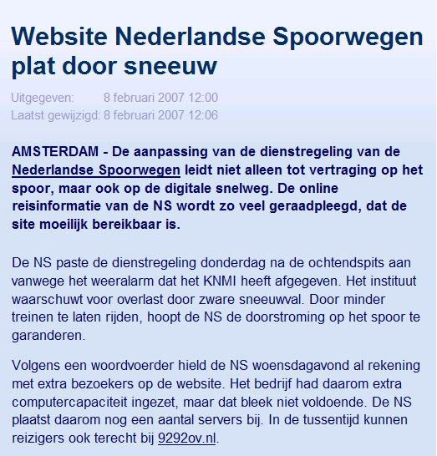
Risk of not testing properly
http://www.nu.nl/internet/969836/website-nederlandse-spoorwegen-plat-door-sneeuw.html
8 February 2007: Website of “Nederlandse Spoorwegen” cannot handle extra traffic caused by bad weather conditions (snow).
NS had changed the timetable because of the expected weather conditions
NS had counted for extra load and had added computer capacity, but (apparently) not enough.

Slide 30
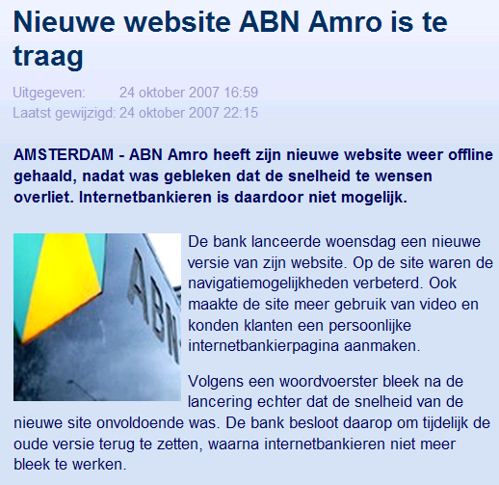
Risk of not testing properly
http://www.nu.nl/news/1286760/50/Nieuwe_website_ABN_Amro_is_te_traag.html
24 October 2007: New website of ABN AMRO does not perform and has to be taken offline
load test was not executed with correct parameters
  Only retrieving .html, no .jpg .gif .cs .js etcetera
  Simulating browser cache for each new user
  Simulated load was 10% of actual load

Slide 31

Risk of not testing properly
http://www.nu.nl/internet/2093190/bel-me-niet-register-al-eerste-dag-plat.html
1 October 2009: New website “bel-me-niet-register” is overloaded
Actual load was much higher than expected

Slide 32
Summary
A Load Test project has many similarities with a software development project
It is very easy to do it wrong, and difficult to do it right
Load test execution may involve many iterations, up to 50, depending on application/middleware quality and infrastructure complexity

Slide 33
Questions ?

